Slide 1
Revizija GDPR usklađenosti
Daniel Bara, PhD
Zagreb, 4th May 2021.

Slide 2

Agenda
1 | Project initiation | 3
2 | GAP analysis | 12
3 | Risk analysis | 14
4 | Defining the budget | 16
5 | Internal acts | 18
6 | Implementation & ongoing review | 37
7 | Open issues | 41
8 | GDPR audit (Internal & External) | 43

Slide 3
Project initiation
1

Slide 4
Project initiation
Align core team (internal and external)
Establish GDPR project plan
Obtain senior leadership approval

Slide 5
Project initiation
Appointment of project team
Attending workshops and seminars
GDPR training
GDPR internal workshop
Appointment of DPO
GDPR documentation study
Internal documentation review

Slide 6
Consider whether required to appoint a data protection officer (DPO)
DPO has inter alia the following tasks:
inform and advice data controller or processor as well as employees;
monitor compliance with data protection laws;
cooperate with and act as contact person for supervisory authorities.
Notes:
Michael Schmidl, Munich

Slide 7
DPO appointment (cont.)
    Private sector organizations will generally be required to appoint a DPO where they process sensitive data on a large scale or engage in regular and systematic monitoring of data subjects on a large scale.
    Even if not mandatory DPO requirement, consider whether to voluntarily appoint a DPO as to discharge their GDPR compliance obligations.
    Data protection authority guidance on appointing a DPO.

Slide 8





Slide 9
Project plan
High level plan
Maping data
Personal data workshop
Personal data maping
Data processing records
Work packages
Coordination meeting

Slide 10
Data mapping step-by-step
Scoping
- "staging the map" – prepare a project plan and the necessary tools and materials bespoke to your needs
- questionnaires/templates/guidance documents
Information Collection
- via questionnaires/interviews collect all required information in order to generate a record of processing
- Consider internal and external resource required for this phase
Information Analysis & Mapping
- based on the information collected and your specific needs, produce data flow maps and analysis to best record and visualise your organization's data processing activities.

Slide 11
Data mapping – the 5Ws of personal data
Who
are we? are our data subjects? has access to personal data?
Where
do we keep their personal data? do we transfer personal data to?
Why
is personal data under our control?
mechanisms do we have in place to safeguard personal data?
When
are we keeping personal data until? do we share personal data with others?
What

Slide 12
GAP analysis
2

Slide 13
GAP analysis
Data processing records analyse
DPIA
Interviews
Personal data maping
Data processing records
Company GDPR requirements
Coordination meeting
Base for budgeting

Slide 14
Risk analysis
3

Slide 15
Risk analysis
Risk to company business
Data subject rights risk analysis
IT architecture:
Right to forget
Right to data portability
Determine high fine risks
Colecting and processing data for lawful purposes
develop organizational and technological mitigations for the identified risks
protect data all the times
required protections
include third party
Right of access
Right to rectification
Right to object
Right to restriction of processing

Slide 16
Defining the budget
4

Slide 17
Risk analysis
Interal resources
Legal costs
Need for external consulting
IT costs
Iternal personel
Vendors and solutions
Preparing implementation

Slide 18
Internal acts
5

Slide 19
13 Key GDPR compliance recommendations
1. Prepare a record of processing activities
2. Establish a global data protection policy and governance
3. Confirm your cross-border data transfer solution
4. Update your global breach notification plan
5. Prepare HR-specific deliverables
6. Prepare customer-specific deliverables
7. Provide guidelines to information asset owners (PbD, PIA)
8. Update IT applications to address rights of data subjects
9. Establish appropriate terms with data processors
10. Confirm suitable information security policies
11. Consider appointing DPO
12. Confirm game plan for one-stop-shop
13. Consider fines and consequences

Slide 20
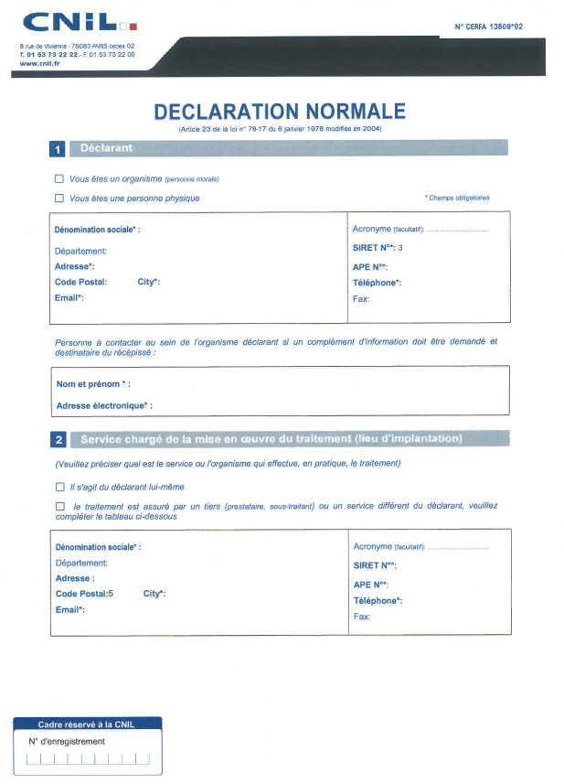
Prepare a record of processing activities
Obligation to maintain records of processing activities:
Identification of the controller(s)/ representative / processor/ DPO
Purposes of the processing
Description of the data subject and of the data processed
Recipients
Transfers
Time limits for erasure
Technical and organisational security measures

Slide 21
Establish a Global Data Protection Policy
  Develop Global Data Protection Policy ("Policy")
  Policy establishes Global Data Protection Steering Committee (multi-disciplinary)
  Policy establishes core principles for the protection of personal data
  Policy provides for the appointment of privacy champions, data protection officers, and other features
  Policy serves as foundational document for other subordinate procedures
Notes:
Michael Schmidl, Munich

Slide 22
Confirm cross-border data transfer solution(s)
1
Privacy Shield
2
Standard contractual clauses (controller or processor)
3
Binding corporate rules
4
consent/other derogations, and potentially emerging codes of conduct, privacy seals, and others

Slide 23
Update incident response policy
Personal data breach
“
a breach of security leading to the accidental or unlawful destruction, loss, alteration, unauthorised disclosure of, or access to, personal data transmitted, stored or otherwise processed
”
not related to the quality / adequacy of the security measures
any incident impacting the c.i.a. trade (Confidentiality, Integrity, Availability)

Slide 24
Update incident response policy (cont.)
DPA Notification
Data Subject Notification
Notification without undue delay in case of high risk to the rights and freedom of individuals
Nature of the breach
Within 72 hours of becoming aware of the breach
DPO identification
Consequences of the breach
No notification if data is encrypted, if technical measures have been taken or if notification involves disproportionate efforts
Measures taken to remedy the breach
Can be done in steps

Slide 25
Prepare HR-specific deliverables
Employee Notice
Cover robust content requirements and consider consent issues
Employee Computer
Use Policy
Notification and consent as needed for computer use monitoring
Procedures for Managers
Respond to access requests and other data subject rights
Other HR deliverables
Updates to Codes of Conduct, Hotlines, Works Council Agreements,
local notices/procedures, other documents

Slide 26
Notice to data subjects (content)
GDPR
Directive
Identity of the controller
Purposes
Obligation to respond to data subject
Right of access, rectification and objection
Recipients
Transferts
Identity of the controller and of the DPO.
Purpose
Conservation period
Right of access, rectification, restriction and objection
Right to lodge a complaint
Recipients
Transfers
Right to withdraw consent at any time
Legitimate interest of the controller or of a third party (if relevant).
Information about profiling…
Any other information guaranteeing the loyalty of the processing
…

Slide 27
Prepare customer specific deliverables
Customer terms
Corporate customer standard terms and playbook for contracting
Privacy Statement
Customer-facing privacy statement(s) for websites, mobile apps,
and other sites and features
Procedures for Managers
Direct marketing procedures, data sharing rules, rules on responding
to access requests/rights of data subjects
Other customer deliverables
Statements for information collection points, consent terms, contracts
for onward transfers to business partners

Slide 28
Determine if consent (ever) needed
Consent is grounds for processing (Article 6(1)), BUT:
New definition of consent requiring a clear affirmative action
New conditions for consent to be valid
New guidance regarding "freely given" consent
New circumstances where explicit consent is required
Local variations for minors' consent

Slide 29
Provide guidelines for information asset owners
Privacy by design
Processing activities have to be planned, designed and performed with data security and, more generally, compliance with the GDPR in mind
Privacy by default
By default, only personal data which are necessary for each specific purpose of the processing shall be processed
By default personal data are not made accessible without the individual's intervention to an indefinite number of individuals

Slide 30
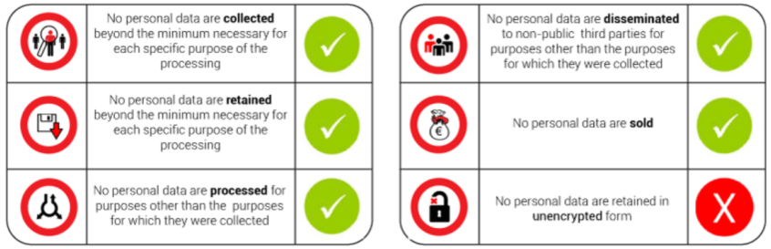
Guidelines for information asset owners (cont.)
Elements of privacy by design and privacy by default
 | No personal data are collected beyond the minimum necessary for each specific purpose of the processing
 | No personal data are retained beyond the minimum necessary for each specific purpose of the processing
 | No personal data are processed for purposes other than the purposes for which they were collected
 | No personal data are disseminated to non-public third parties for purposes other than the purposes for which they were collected
 | No personal data are sold
 | No personal data are retained in unencrypted form
✓
✓
✓
✓
✓
✗

Slide 31
Guidance to information asset owners (cont.)
Impact assessment (art. 35)
Privacy Impact Assessment (PIA) is mandatory when the processing is likely to result in a high risk for the rights and freedom of individuals. It should include:
A description of the processing
An assessment of the necessity and proportionality of the processing operations in relation to the purposes
Involvement of the Data protection officer (DPO) where one is designated
Requires consultation with the Supervisory Authority (SA) if controller does not mitigate the high risk

Slide 32
Upgrade IT applications to conform to performance standards for data subject rights
    Logging of sources of personal data, and internal and external access
    Features to execute on data subject rights of access, correction, objection, profiling, data portability, and deletion (forgotten)
    Functionality that facilitates the secure destruction of personal data when no longer required for legitimate business and compliance purposes, in accordance with record retention policies

Slide 33
Address requirements for data processors
  Controller must establish a contract that covers:
    Description of subject-matter and duration of the processing
    Description of nature and purpose of the processing
    Types of personal data and categories of data subjects
    Obligations and rights for Controller (responsibilities and audit rights)
  Direct obligations on data processors, such as
    Commit personnel to data secrecy
    Assist Controller to respond to data subject's rights
    Comply with security measures
    Assist Controller with security breach and DPIAs
    Cooperate in case of audits, including inspections

Slide 34
Compliance recommendations
3

Slide 35
Game plan for one-stop-shop (OSS)
1
Identify your main establishment
2
Monitor your Lead SA closely for guidance and enforcement priorities
3
Build good relations with your Lead SA
4
Identify likely Concerned SA that your Lead SA will liaise with
5
Monitor communications from the EDPB and SAs on how the OSS with be interpreted and applied in practice

Slide 36
Consider fines and consequences
€ 10M
2% of total worldwide annual turnover of preceding financial year
€ 20M
4% of total worldwide annual turnover of preceding financial year
Example
Infringement of obligations regarding data protection by design or by default
Example
Infringement of basic principles for processing, data subjects' rights, or obligations pursuant to Member State laws adopted under the GDPR

Slide 37
Implementation & ongoing review
6
Notes:
Michael Schmidl, Munich

Slide 38
Implementation (snapshot)
Assess relative priority of compliance recommendations, and make strategic decisions
Establish implementation step list
Set realistic timelines and assign sufficient resources
Continue with ongoing review and improvements to the data protection program
Keep senior management apprised of progress

Slide 39
Implementation list
Data Loss Prevention
Pseudonymization
Network and endpoint security
File sharing
Privileged account management

Slide 40
Implementation list
Automated tools
Behavioral analytics
Mobile Data Management
Data Export
Anti malware and anti ransomware

Slide 41
Open issues
7
Notes:
Michael Schmidl, Munich

Slide 42
Open issues solution
Employee awareness and education
FAQ page will be established, as well as google survey with multiple choices question regarding GDPR and personal data protection. Statement of GDPR awareness and education. Clear obligations and accountabilities.
Internal documentation review
All other internal documents should be checked and harmonized with newly produced and GDPR requirements if that is not already done.

Slide 43
GDPR audit (Internal & External)
8
Notes:
Michael Schmidl, Munich

Slide 44
End game: Actual demonstrated compliance
Policies & measures
Notification of Personal Data Breaches
Record of all the processing
Well-Functioning Governance Structures
Policies Procedures Measures
Information Policies
Significant number of items to be provided
In an intelligible form
May be done electronically
Appropriate safeguards for cross-border transfers
Suitable Risks Analysis
Privacy Impact Assessments
Privacy by Design
Privacy by Default
Training

